Slide 1
AdTracking Fraud Detection
ML – Final Project
Chiranjeevi Mallavarapu
MSDS – SMU
2018

Slide 2
Introduction
What is Fraud in Ad world?
Click fraud can happen at high volume
Companies end up paying for misleading click data and thus wasted money
World total population 7.7 Billion : Total mobile cell phones in use 7 billion
Source : TalkingData (a kaggle dataset) : 70% China’s mobile devices : 3 billion clicks/day

Slide 3
How it is done today? What Next?
Understanding the current methodology:
Journey of a user’s click across their portfolio
Flag IPs that produce lot of clicks that doesn't install apps
In this project we will use ML techniques to predict

Slide 4
Source Data
What data do we have?
Our training dataset consists of 100,000 rows of data. Each row of the training data contains a click record, with the following features.
ip: ip address of click.
app: app id for marketing.
device: device type id of user mobile phone (e.g., iphone 6 plus, iphone 7, huawei mate 7, etc.)
os: os version id of user mobile phone
channel: channel id of mobile ad publisher
click_time: timestamp of click (UTC)
attributed_time: if user download the app for after clicking an ad, this is the time of the app download
is_attributed: indicating the app was downloaded
response : Derived from is_attributed - 1 if fraud , 0 if genuine click

Slide 5
Data Exploration
Fraud
Geunine
Imbalanced Data
Clearly certain apps/devices/OS are always used for fraud

Slide 6
First Neural Network Dense/Fully Connected Architecture
SMOTEENN
Balance Data
8
12
16
12
2
8
Accuracy = 78.70%

Slide 7
Second Neural Network CNN 80/20 split batch size 20,000 Epochs 100
Conv
16 layers
3 dim filters
Conv
64 layers
3 dim filters
Conv
16 layers
3 dim filters
Dense
25
Dense
2
Accuracy = 73.66%
Precision = 66.39%
Recall = 91.72%

Slide 8
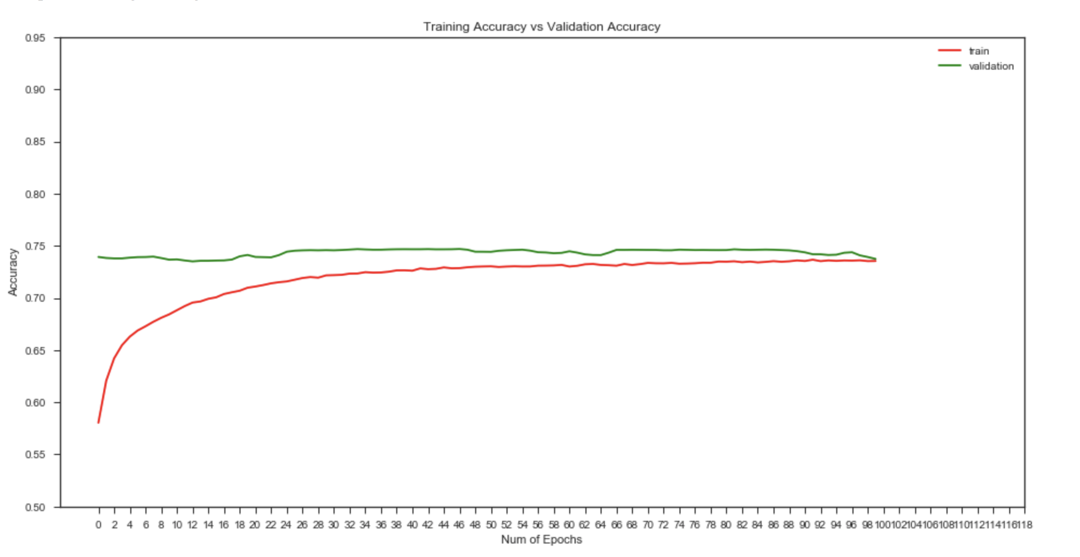
Train/Test accuracy

Slide 9
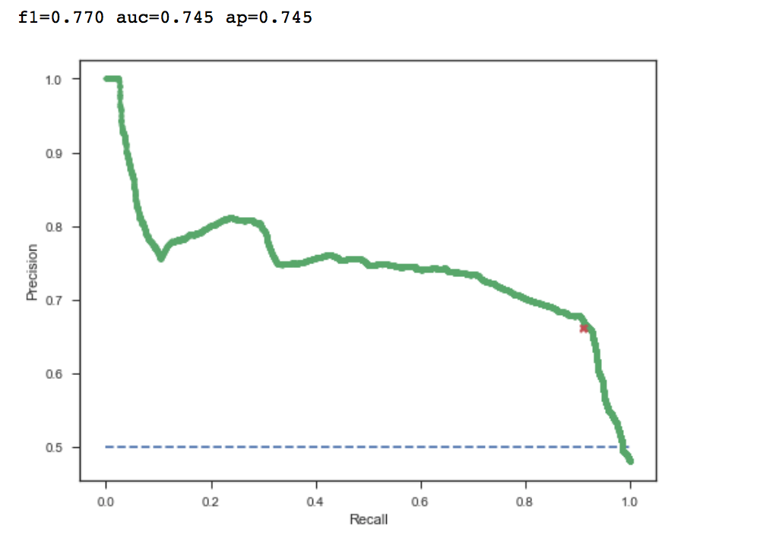
Precision / Recall
A Recall of 91%* and a precision of 66% gives the best accuracy/F1 score
*A Recall of 91% is really important in this case as it tells how good can
we catch fraud

Slide 10
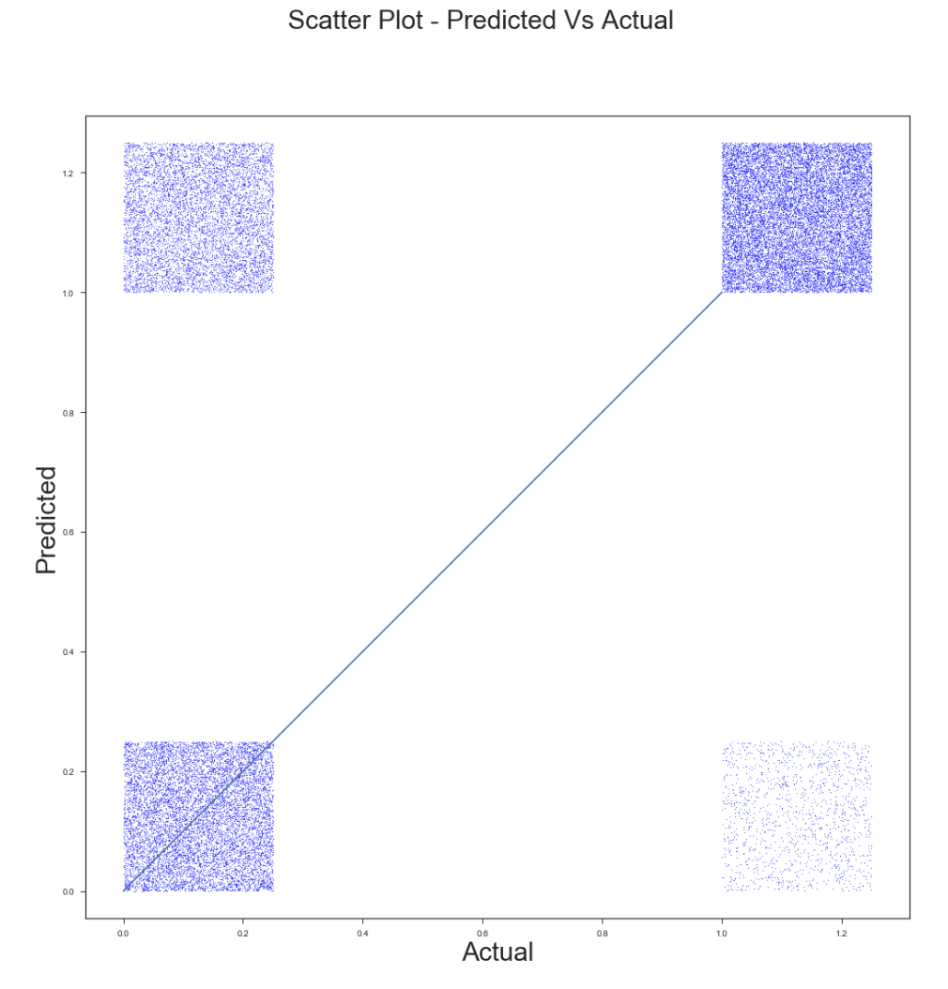
Predicted vs Actual
RECALL
PRECISION

Slide 11
Conclusion
A CNN with the architecture mentioned resulted a satisfying model that has an accuracy of 74% and Precision of 66% and Recall of 92%. In this use case, as it is more important to catch fraudulent clicks a 92% recall is a great performance. This model can be implemented on ad stack within any DSP (e.g. tradedesk) to filter all fraudulent clicks.

Slide 12
Future Work
The features can be further engineered to get a better accuracy / precision in addition to a good recall. I propose to include below additional features as a part of dataset and rerun the model to get better prediction
Geo location of the IP
Indicate any IP repititions
Day/Time of the fraud
Device+OS combination

Slide 13
End Note
Thank you!

